Slide 1
Project 2 Overview
ASU Computer Architecture

Slide 2
Can you make your own branch predictor?
But First….

Slide 3
What is a branch predictor?
A branch predictor is a digital circuit in a microprocessor that predicts the outcome of conditional branches in a program's code. The goal of a branch predictor is to improve the flow of instructions in a pipeline and increase performance.
Note: Branch predictors will be covered in detail in the upcoming classes.

Slide 4
Before starting this project
Please make sure your modifications in source code or configuration of parameters made during previous projects are reverted back. If not, please correct them or obtain a new copy of gem5 from Canvas and then rebuild gem5.

Slide 5
Tasks in project 2
The branch predictor that you will implement is 2-bit bi-mode branch predictor.
You can find the implementation in the directory at gem5/src/cpu/pred/ in the files 2bit_local.cc, 2bit_local.hh, tournament.cc and tournament.hh.
Explanation about branch predictors:
- 2b local BP:
https://courses.cs.washington.edu/courses/csep548/06au/lectures/branchPred.pdf
- bi-mode BP: https://tnm.engin.umich.edu/wp-content/uploads/sites/353/2017/12/1997.12.Thebimode-branch-predictor.pdf
- tournament BP:
https://www.inf.ed.ac.uk/teaching/courses/car/Notes/2017-18/lecture05handling_hazards.pdf

Slide 6
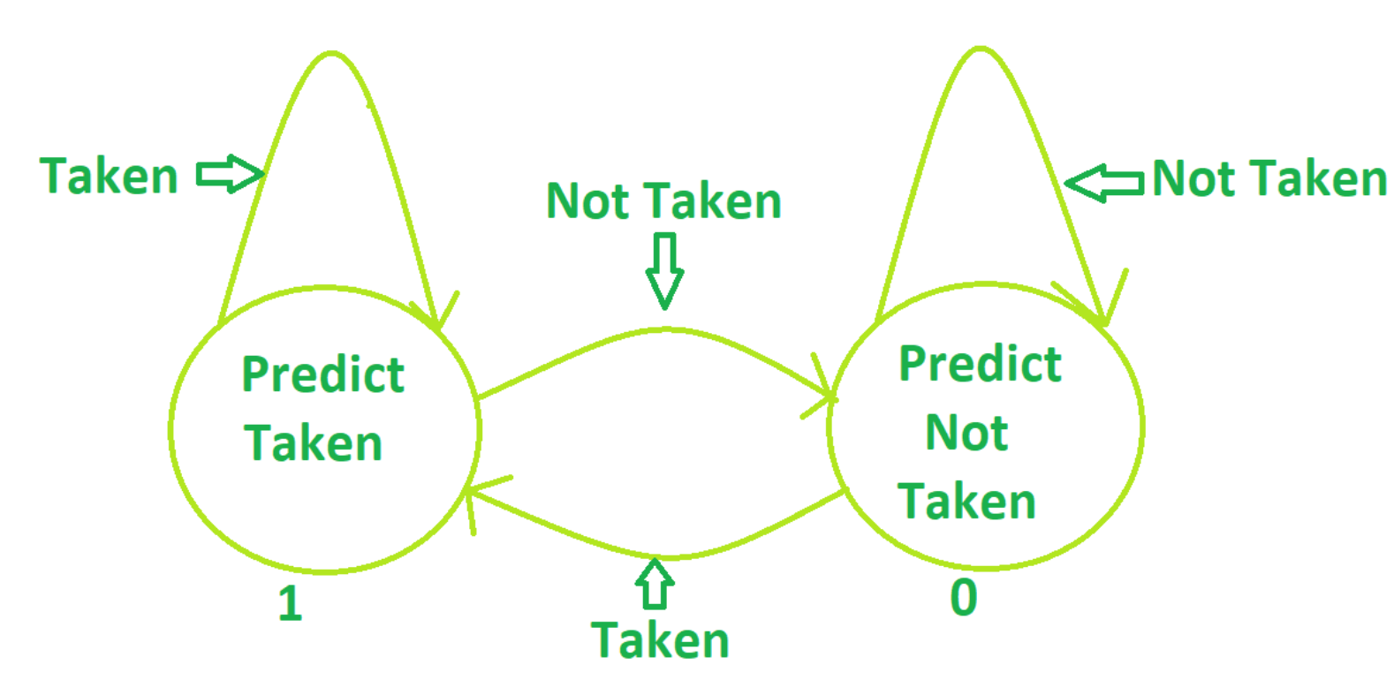
1-Bit Branch Predictor

Slide 7
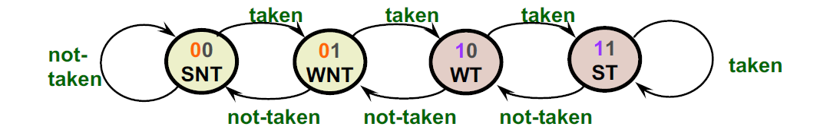
2-bit Branch Predictor

Slide 8
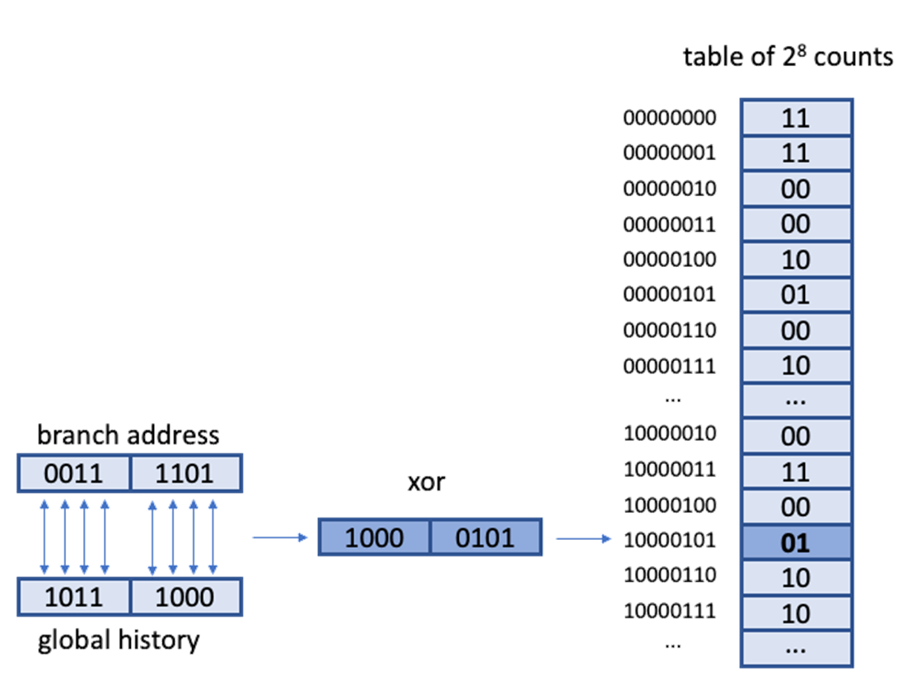
GShare Predictor Calculation
What is the prediction at branch
address 0x0011 1101, where the
global history is 0x1011 1000?
Assume we are using an 8/8
scheme.
The XOR of both values is:
0x1000 0101. We will then use this
to index into the table of counts.

Slide 9
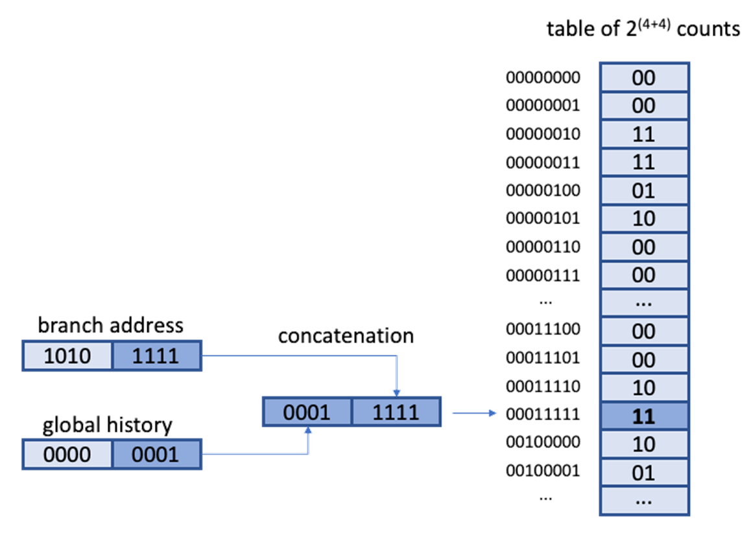
GSelect Predictor Calculation
What is the prediction at branch address 0x1010 1111,
where the global history is 0x0000 0001?
Assume we are using a 4/4 scheme.
The final 4 bits of the branch address are “1111” and the
final 4 bits of the global history are “0001”.
The concatenation is therefore: 0x0001 1111.
We will then use this to index into the table of counts.

Slide 10
Bi-Mode Branch Predictor
The bi-mode predictor is a two-level branch predictor that has three separate history arrays: a taken array, a not-taken array, and a choice array. The taken/not-taken arrays are indexed by a hash of the PC and the global history. The choice array is indexed by the PC only.

Slide 11
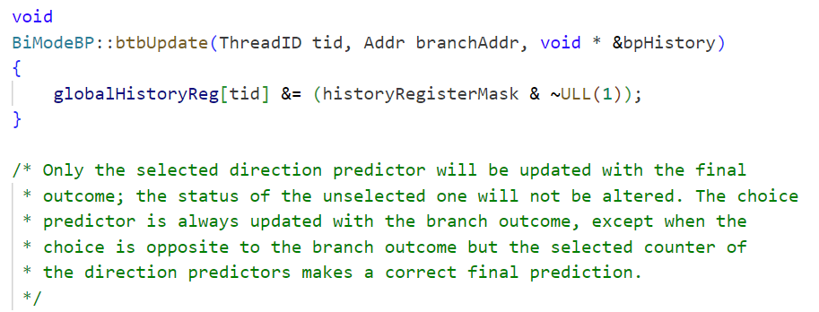
Bi-Mode Branch Predictor
/gem5/src/cpu/pred

Slide 12
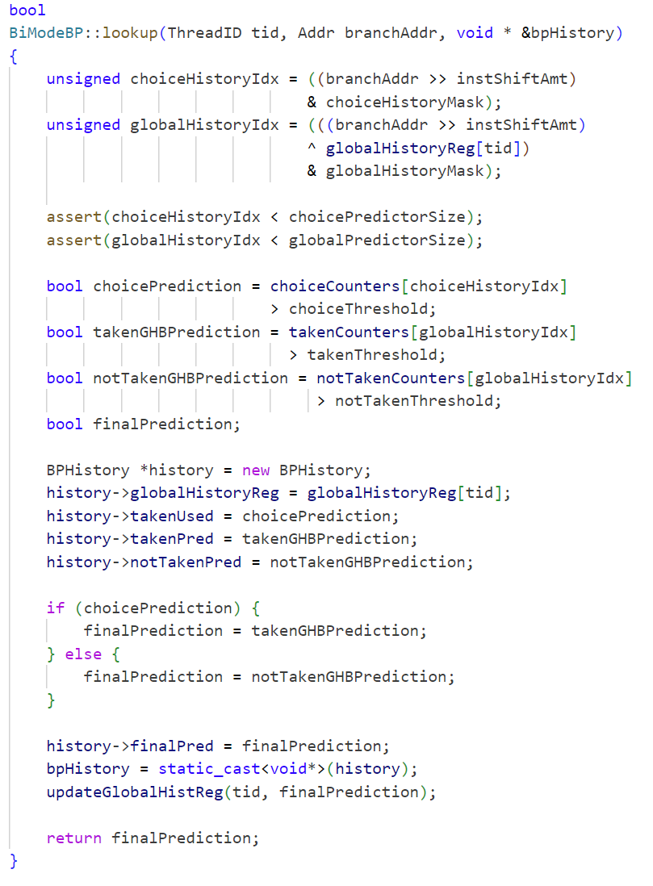
Bi-Mode Branch Predictor

Slide 13
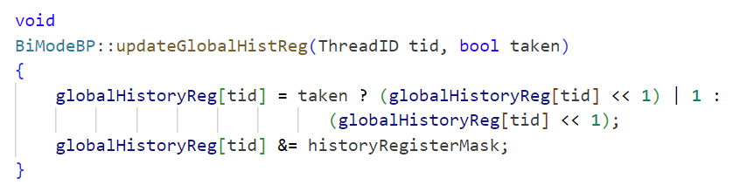
Bi-Mode Branch Predictor

Slide 14
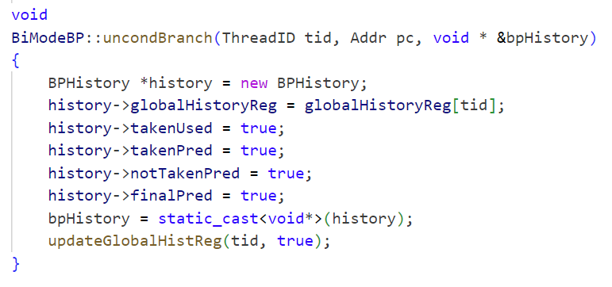
Bi-Mode Branch Predictor

Slide 15
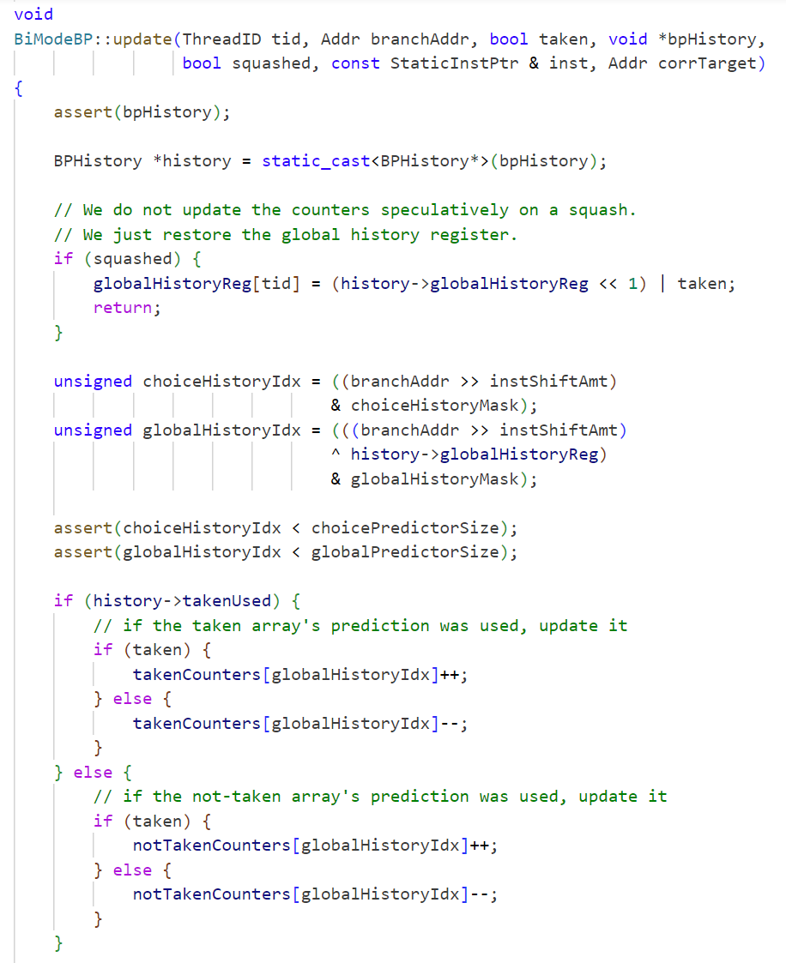
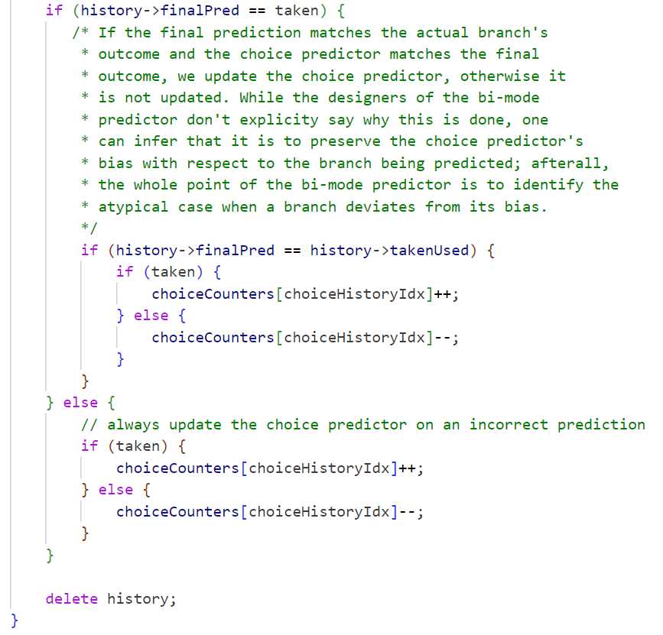
Bi-Mode Branch Predictor

Slide 16
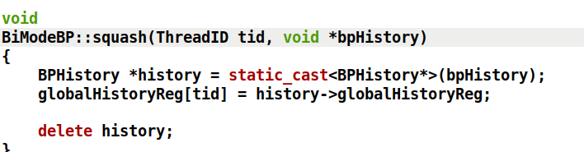
Bi-Mode Branch Predictor

Slide 17
Tasks in Project 2
Make necessary changes in BranchPredictor.py file.
class CustomBP(BranchPredictor):
type = 'CustomBP'
cxx_class = 'CustomBP'
cxx_header = "cpu/pred/custom.hh"
PredictorSize = Param.Unsigned(1024, "Size of predictor (entries).")
PHTCtrBits = Param.Unsigned(2, "Bits per counter.")
globalHistoryBits = Param.Unsigned(8, "Bits of the global history.")
‘gem5/src/cpu/pred’

Slide 18
Tasks in Project 2
Make necessary changes in ‘SConscript’ file.
Source('custom.cc')
DebugFlag('Mispredict')
DebugFlag('CDebug')

Slide 19
Tasks in Project 2
Write the code for custom branch predictor.
Create 2 files custom.cc and custom.hh in the directory of gem5/src/cpu/pred/.
These 2 custom files should be submitted separately as well.
You will need to define and implement the functionality for the five main branch predictor functions:

Slide 20
Functions to Implement
Constructor():
calculate the PHThistoryBits bits using the PredictorSize
calculate the b BranchAddressBits
calculate the BranchMask
calculate the globalHistoryMask
calculate the PHTThreshold

Slide 21
Functions to Implement
uncondBranch():
modify the history using the thread.
modify the prediction attribute and global history
attribute of the history.
squash():
modify the globalHistoryReg of the thread.
delete the history.

Slide 22
Functions to Implement
lookup():
define ‘n’ bits of global history and ‘n’ bit of branch address.
calculate the PHTIdx using ‘n’ and ‘n’
modify the history using the thread
to determine a prediction.
btbUpdate():
modify the globalHistoryReg of the thread.

Slide 23
Functions to Implement
update():
modify the history.
if squashed {do something}, otherwise {do something else}.
calculate PHTIdx using m and n.
update PHTCounters accordingly to whether the branch is taken or not.
delete the history
.

Slide 24
Tasks in project 2
The operations and the no. of bits for each group will be different. The way to find out which configuration is assigned to your group is provided in the file Find_my_configuration.pdf
Group_leaders_asu_id%18 = configuration.
Once the implementation is done rebuild gem5. (Commands provided in instructions)

Slide 25
Tasks in project 2
Run the benchmarks to test your branch predictor.
Run the benchmark from the main “gem5” folder.
(Commands provided in the instructions)

Slide 26
After populating all folders with their stats, zip Project2-Submission and submit it to Canvas.
gem5
benchmarks
gem5 source code
other gem5 files
Project2-Submission
Problem 1
custom.cc
conf1
config.ini
config.json
stats.txt
custom.hh
Problem 2
Problem 3
conf1
conf1
config.ini
config.json
stats.txt
config.ini
config.json
stats.txt

Slide 27
Some Helpful Tips
Source code modifications
Don’t forget to rebuild gem5.
Apply enhancements incrementally.
Execution
Ensure configuration options are correct (–l2cache instead of --l2caches).
Make sure specified paths are correct.
Ensure command-line options for program are correct.
Debug
Make sure modified logic is correct. You can try out as standalone and check it.
Use DPRINTF (Using debug flags in gem5).
Submission Related
Make sure your files follow appropriate naming conventions and directory structure. Incorrect naming conventions or directory structures may be heavily penalized.
Double-check that everything is correct before building.
Do not forget to reset values after each problem.
Notes:
https://www.gem5.org/documentation/general_docs/cpu_models/SimpleCPU

